Slide 1
Welcome to Core Java Sessions
Topic : Array

Slide 2
Agenda/Topics to Be Covered
What is Array ?
Array Declaration & Construction
Array Initialization
Length of an Array
Types of Array
Two Dimensional Array
Three Dimensional Array
Advantages and disadvantages of Array

Slide 3
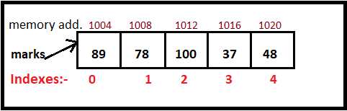
What is Array ?
Need for an array arises from a situation where we want to store multiple values of same data type. Eg:- marks of subjects. → int mMaths , int mScience , …………. int mSocials.
Array in simple words is a collection of similar type of elements which has contiguous memory location.
Array in Java is index-based, the first element of the array is stored at the 0th index, 2nd element is stored on 1st index and so on.

Slide 4
Array Declaration & Construction:-
Declaration :- Single dimensional Arrays can be declared in following ways :- int[] marks; int []marks; int marks[]; String[] names;
Construction :- Arrays are internally objects in java hence can be constructed using “new” keyword as follows. int[] values = new int[5]; …..Here an array of size 5 is constructed in memory
Here note that while creation the size is mandatory to be given if not given compile time error will occur. Zero size is also not allowed.

Slide 5
Array Initialization :-
Array elements are initialized by default at creation time to its default values.

Slide 6
Variables in Java:-
Variable in Java is a data container that saves the data values during Java program execution. Every variable is assigned a data type that designates the type and quantity of value it can hold.
In Java, all variables must be declared before use.
Examples :- int age;
Here int is data type which represent what type of data will be stored and age is the name of variable which will point to the memory location where data will be stored.
So general way to declare variable is :- dataType varName;
Ex:- String name, int count , double rateOfInt; …etc.

Slide 7
Variable visualization :-
int age;
age = 20 ;
double roi ;
roi = 5.4 ;
Java Memory Area
age
20
roi
5.4

Slide 8
Java Reserved Keywords :-
There are some keywords in Java which has special/specified meaning defined by Java.
DataTypes - (boolean, byte, short, char, int, long, float, double)
Special return type of method - ( void )
Flow Controls - (if, else, switch, case, default, for, do, while, break, continue, return, goto (not used))
Access/Type Modifiers - (public, private, protected, static, final, abstract, synchronized, native, strictfp(1.2 version), transient, volatile).
Exception handling - ( try, catch, finally, throw, throws, assert(1.4 version) )
class/interface related - ( class, package, import, extends, implements, interface)
Object related - (new, instanceOf, super, this)
Literals - true, false -- used for boolean data type values, null - default value for object reference. " " "" --
For Enumerations – Enum.

Slide 9
Software Setup :-
Install Eclipse latest version on your system.
Download and install Java 8.

Slide 10
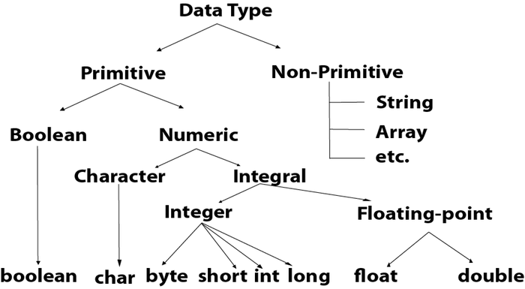
Data Types in Java:-
Java is a strongly typed language. And thus every variable must be declared with a data type.

Slide 11
Primitive Data Types :-
Primitive types are predefined (already defined) in Java, and are the fundamental data types for Java. There are total 8 primitive Data types. All of these will be have name in lower case.
And based on the type of primitive data appropriate memory is allocated in Java memory space.
Primitive Data types are further divided as shown in figure previously.
Programmer must choose appropriate data type as per the need in such a way that, the data type should be able to hold the required data and also there should be no unnecessary wastage of memory.

Slide 12
boolean data Type :-
To represent/save/hold the boolean values the data type provided by Java is boolean. It requires only 1 bit in memory to be stored.
boolean can have only 2 values :- true , false (Note :- all lower case and without and inverted commas.) Default value for boolean type is false.
Examples :-
boolean flag ; // defining a Boolean type variable ,default value - false
flag = true ; // assigning value true to the boolean type variable.
boolean isCorrect = true ; //declaring variable & assign value in 1 statement
isCorrect = False ; //// invalid
isCorrect = “false” ; //invalid

Slide 13
char data type :-
Used to store/hold single character. Needs 16 bits (2 Bytes) in memory. Values are assigned in single inverted comma.
It represents character representation of ASCII values. Integer value can also be assigned, it will hold corresponding ASCII character.
default value is :- \u0000.
Examples :-
char c ; char charcterEx = ‘x’ ; char a = 98 ; | char value = “j” // invalid. char val = q // invalid

Slide 14
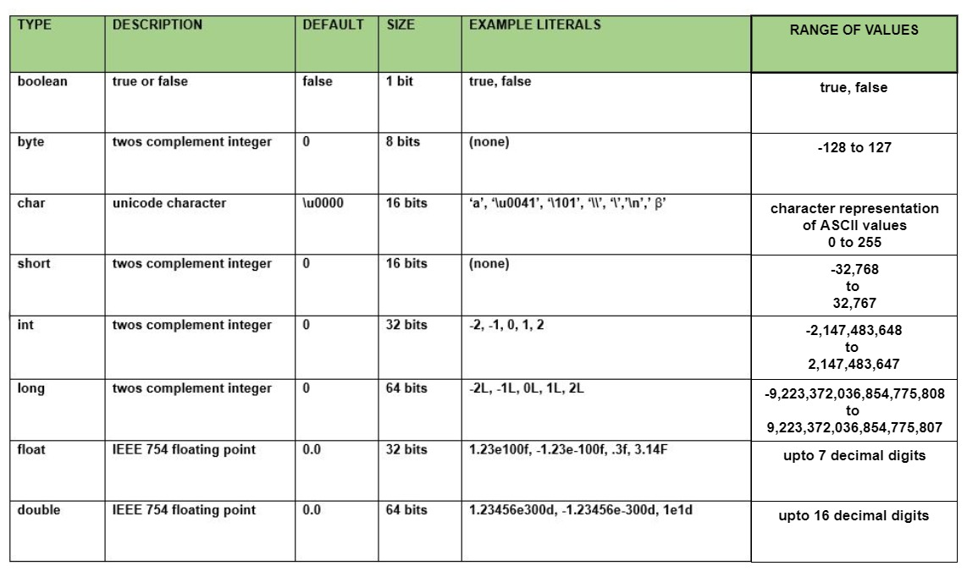
Data Types :-

